Slide 1
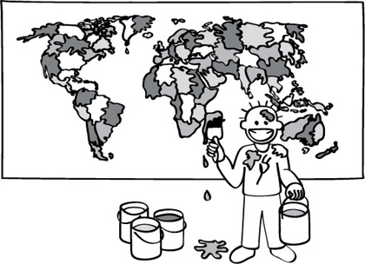
Graph Colouring
Find the minimum amount of colours needed to colour in the provided map of the world so that no two touching regions are the same colour

Slide 2
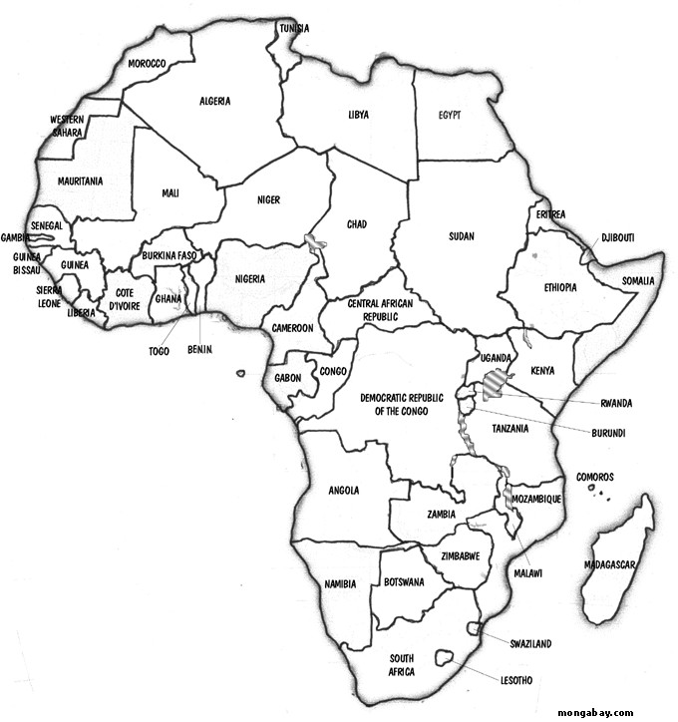

Slide 3
Modeling an Intersection
‘vroom vroom’

Slide 4
What possible flows are there through this intersection?
What is the minimum number of light sequences needed to allow all traffic to pass through this intersection?

Slide 5
What possible flows are there through this intersection?
B
C
D
F
E
What is the minimum number of light sequences needed to allow all traffic to pass through this intersection?
A

Slide 6
AB
B
EB
CD
C
D
F
E
CB
EF
A
AD
AF

Slide 7
AB
B
EB
CD
C
D
F
E
CB
EF
A
AD
AF

Slide 8
AB
B
EB
CD
C
D
F
E
CB
EF
A
AD
AF

Slide 9
AB
B
EB
CD
C
D
F
E
CB
EF
A
AD
AF

Slide 10
AB
B
EB
CD
C
D
F
E
CB
EF
A
AD
AF

Slide 11
AB
B
EB
CD
C
D
F
E
CB
EF
A
AD
AF

Slide 12
AB
B
EB
CD
C
D
F
E
CB
EF
A
AD
AF

Slide 13
AB
B
EB
CD
C
D
F
E
CB
EF
A
AD
AF

Slide 14
AB
B
EB
CD
C
D
F
E
CB
EF
A
AD
AF

Slide 15
AB
B
EB
CD
C
D
F
E
CB
EF
A
AD
AF

Slide 16
AB
B
EB
CD
C
D
F
E
CB
EF
A
AD
AF

Slide 17
AB
B
EB
CD
C
D
F
E
CB
EF
A
AD
AF

Slide 18
AB
B
EB
CD
C
D
F
E
CB
EF
A
AD
AF

Slide 19
AB
B
EB
CD
C
D
F
E
CB
EF
A
AD
AF

Slide 20
AB
B
EB
CD
C
D
F
E
CB
EF
A
AD
AF

Slide 21
AB
B
EB
CD
C
D
F
E
CB
EF
A
AD
AF

Slide 22
AB
B
EB
CD
C
D
F
E
CB
EF
A
AD
AF

Slide 23
AB
B
EB
CD
C
D
F
E
CB
EF
A
AD
AF

Slide 24
AB
B
EB
CD
C
D
F
E
CB
EF
A
AD
AF

Slide 25
AB
B
EB
CD
C
D
F
E
CB
EF
A
AD
AF

Slide 26
AB
B
EB
CD
C
D
F
E
CB
EF
A
AD
AF

